Slide 1
Securing Networks:
Navigating the Zero Trust Paradigm with SSH and NIDS
Chilappagari Anantha Krishna
1
Geethika Sai Kallaganti
2
Deepthi Gatla
3
Guna Sindhu Priya Singamaneni
4
Deva Tulasi Komatineni
5

Slide 2
AGENDA
INTRODUCTION
SSH KEY USER FLOW
NECESSITY OF ZTA
CONCLUSION
CHALLENGES
REFERENCES
ZTA PROTECTION
Multi Factor Authentication
Network Intrusion Detection
NIDS CMAP
NIDS USER FLOW
SSH KEY
SSH KEY CMAP

Slide 3
ZERO TRUST ARCHITECTURE
Zero Trust Architecture is a cybersecurity framework that redefines traditional perimeter-based security, operating under the core principle of maintaining strict access controls and trust verification for every user, device, and network component, regardless of their location or source.
Identity Verification: ZTA eliminates the implicit trust in entities inside a network and requires continuous identity verification, ensuring users and devices are authenticated before granting access.
Least Privilege Access: It operates on the principle of least privilege, granting users the minimal level of access required for their specific tasks, thereby reducing the attack surface.
Continuous Monitoring: ZTA emphasizes continuous monitoring and real-time assessments of user behavior and device health, detecting anomalies and potential threats promptly.

Slide 4
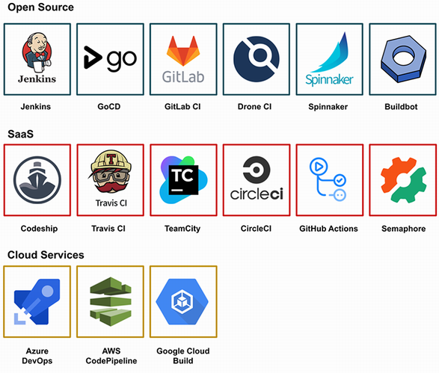
_{WHY ZTA}
ZTA ADDS AN EXTRA LAYER OF SECURITY BINDING ALL THE APPLICATIONS OF AN ORGANISATION IN A SHELL.
ONE HAS TO CROSS ZTA SECURITY LAYER TO ENTER EITHER INTO THE NETWORK OR ACCESS PERMISSIONS UNORTHODOXLY
Helps in Reliability and Trust

Slide 5

Why ZTA?
NEVER TRUST ALWAYS VERIFY
Reliability
Extra Security Layer
Trust
ZTA IMPLEMENTATION
VERIFY YOUR IDENTITY
INTRUDER

Slide 6
Challenges Solved By ZTA
Challenge 1
Challenge 2
Challenge 3
Insider Threat
Prevent Insider Threats by proper background verification, Proper Training and Proper Monitoring
ZTA makes sure of verifying user before granting access
Outsider Threat
Preventing Outsider threat is to continuously monitor the attacks, upgrade systems, patching, Implementing Firewalls
ZTA Blocks unregistered IP
Loophole in Security
Attackers often check for loopholes in security to break the system, gain access. Unmonitored traffic is one of the key reasons
ZTA verifies the user Always so that he never escapes

Slide 7



ARCHITECTURE BEFORE ZTA
Idea
Without ZTA
Attacker Observes you Attacker Replicates you Breaks the system

Slide 8
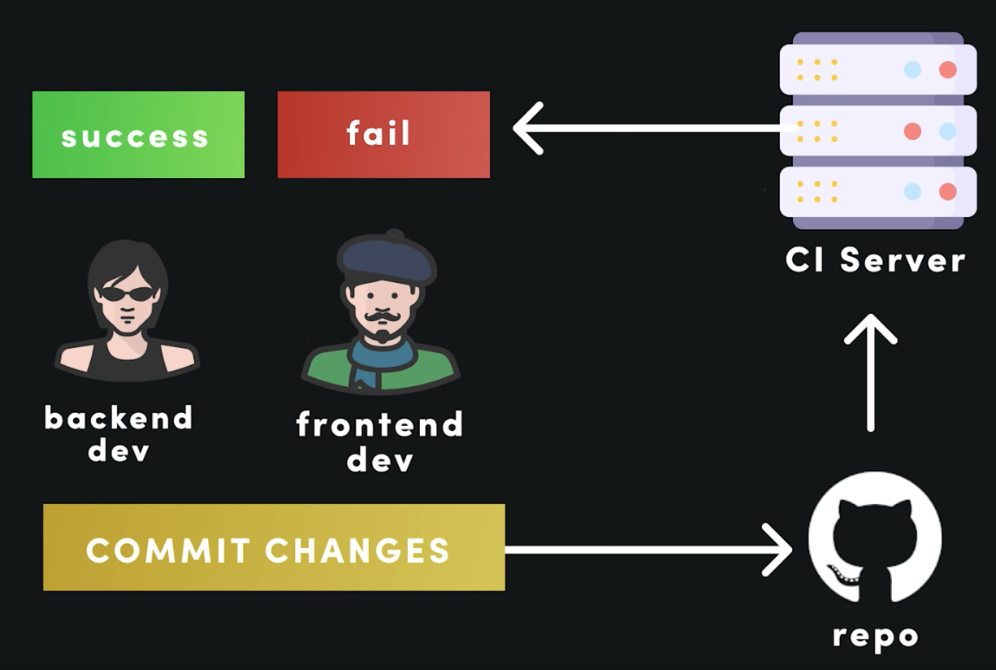
ARCHITECTURE AFTER ZTA
Deny
Accept
ZTA extra layer
Hacker
Legit User
Request Login
Security

Slide 9
MULTI FACTOR AUTHENTICATION
Multi-Factor Authentication is an authentication method that requires users to provide two or more forms of verification before granting access, significantly enhancing security beyond traditional password-based systems.
Enhanced Verification: MFA adds multiple layers of verification, such as biometrics, OTPs, smart cards, or tokens, minimizing the risk of unauthorized access even if one factor is compromised.
Continuous Trust Verification: It aligns with the concept of continuous trust verification by requiring ongoing authentication, ensuring users' identities remain validated throughout their session.
Adaptive Security: MFA can adapt security measures based on risk assessments, adjusting authentication requirements according to the sensitivity of accessed resources or the user's context.

Slide 10






ZTA FUNCTIONALITY USING MFA
LOGIN VERIFY DATABASE REQUEST MFA MFA SENT VERIFIED LOGGED IN REPEAT

Slide 11
NETWORK INTRUSION DETECTION SYSTEM
Network Intrusion Detection Systems are security tools designed to monitor network traffic for suspicious activities, intrusions, or policy violations that may indicate unauthorized access or cyber threats.
Real-Time Threat Detection: NIDS continuously monitors network traffic patterns and behavior to detect and alert security teams about potential threats or intrusions as they occur.
Pattern Recognition: It employs pattern recognition and signature-based detection methods to identify known attack patterns or behaviors indicative of a potential attack, enabling rapid response.
Packet Analysis and Inspection: NIDS inspects individual packets of data, analyzing their content and headers for anomalies, thus allowing for a deeper understanding of potential threats.
Containers in the Cloud
Containers
VMs and Hypervisors
CI/CD
Automated Tests

Slide 12
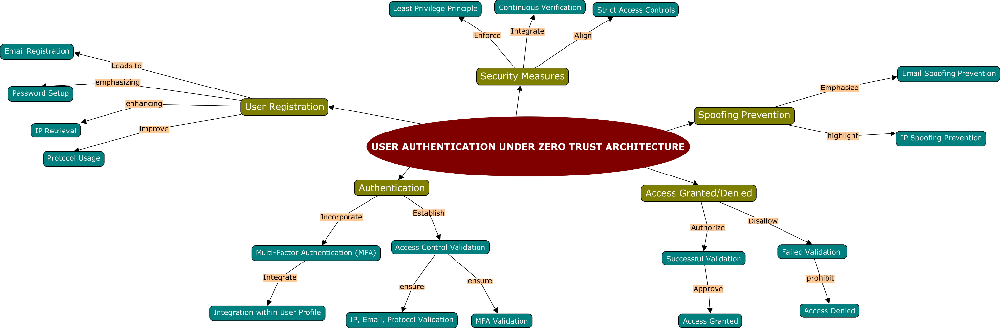
NIDS CONCEPT MAP

Slide 13
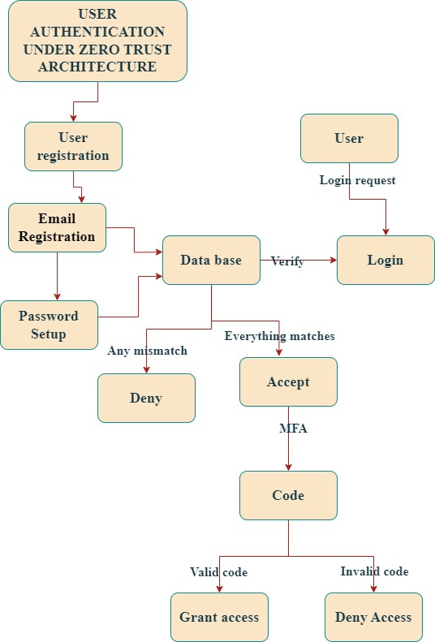
USER FLOW OF NIDS IMPLEMENTING ZTA

Slide 14
SECURE SHELL
Secure Shell is a cryptographic network protocol that provides a secure way to access and manage remote servers and devices, offering encrypted communication and secure authentication mechanisms.
Encrypted Communication: SSH encrypts data transmission between a client and a server, preventing eavesdropping or interception of sensitive information during remote sessions.
Key-Based Authentication: It uses public-key cryptography for authentication, offering a more secure alternative to password-based authentication methods, reducing the risk of brute-force attacks.
Access Control: SSH enables granular access control, allowing administrators to define and enforce access policies, including key rotation, passphrase protection, and centralized key management.

Slide 15

NO OF BITS IN SSH KEY
ALGORITHMS TO GENERATE SSH
Rivest, Shamir, Adleman
Digital Signature Algorithm
Elliptic Curve Digital Signature
RSA
1024
2048
4096
ECDSA
256
284
521
DSA : 1048

Slide 16
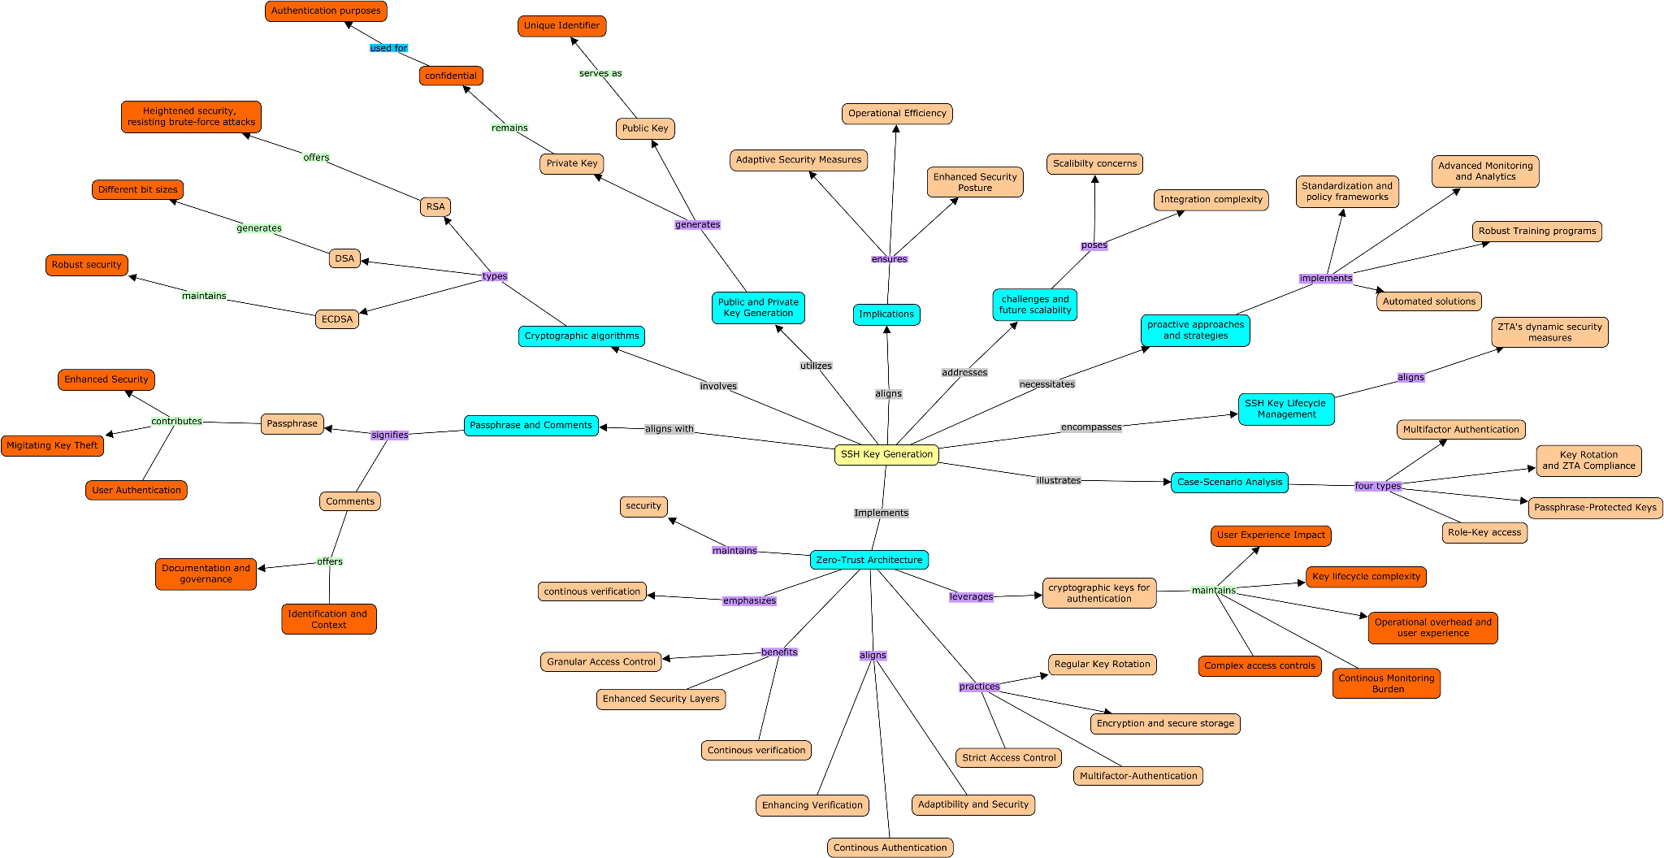
SSH CONCEPT MAP

Slide 17
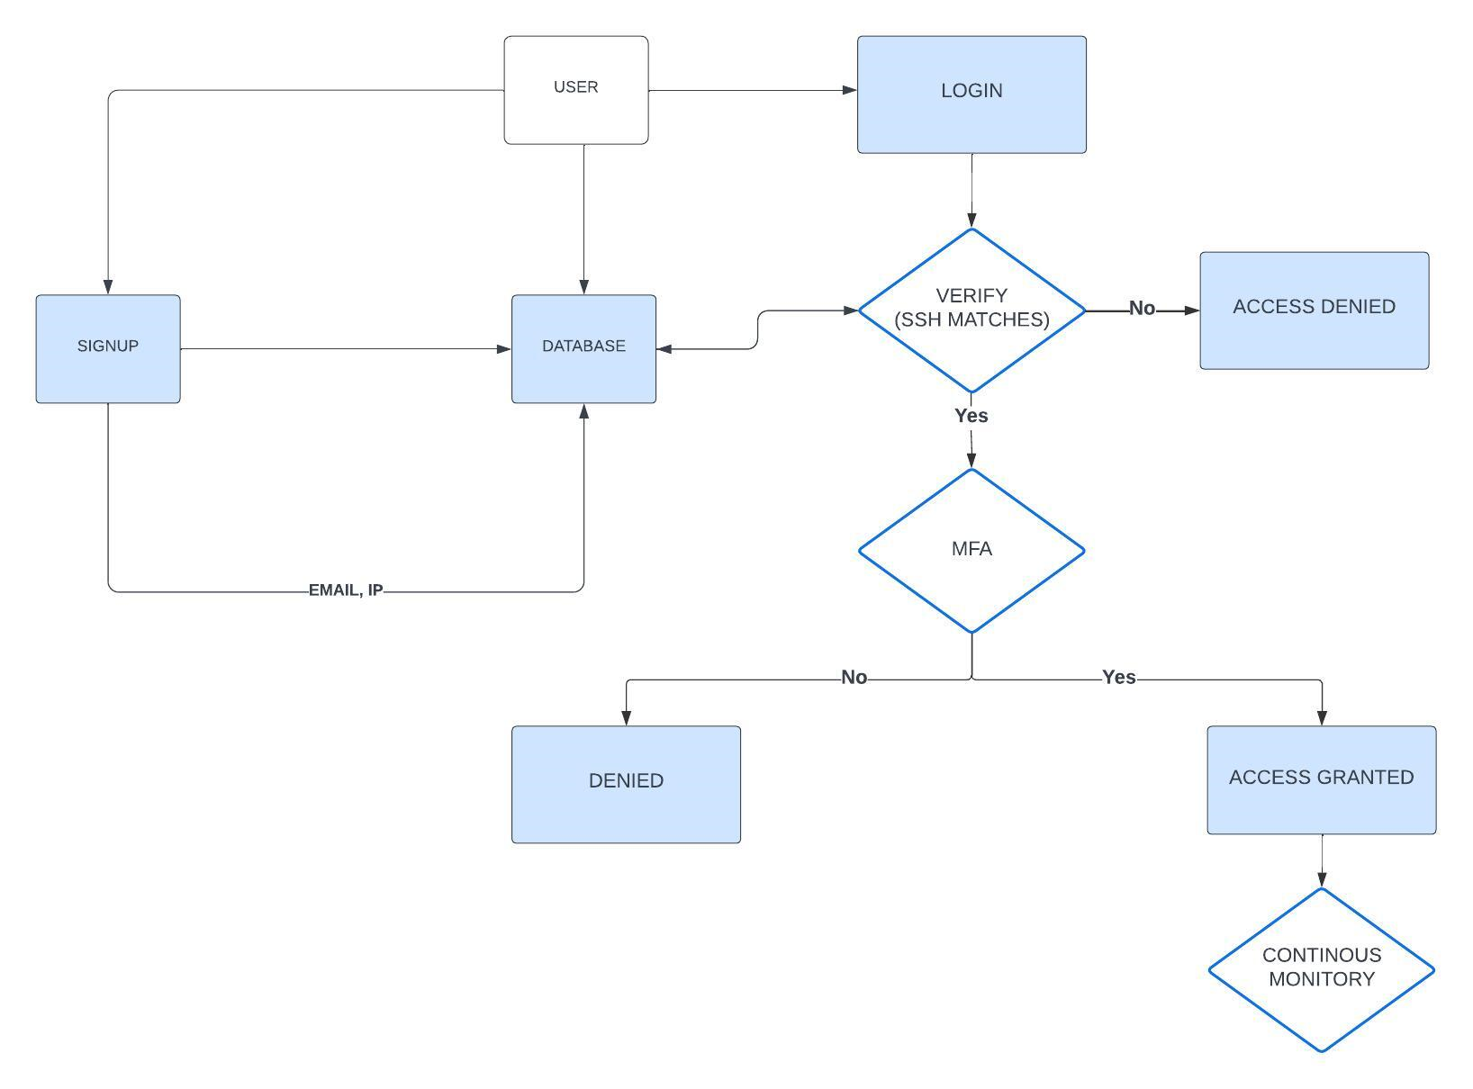
USER FLOW OF SSH
IN ZTA

Slide 18
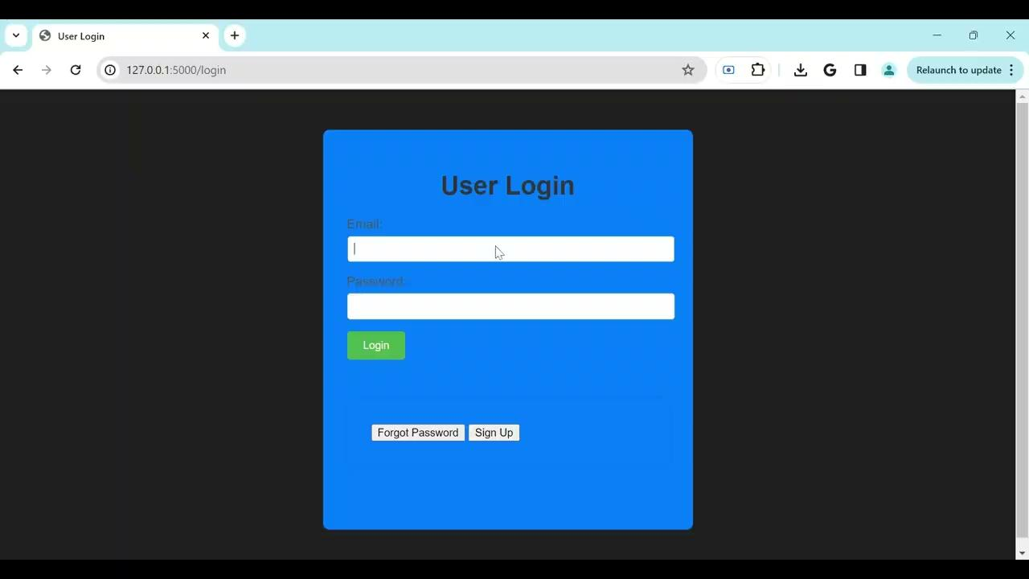
LEGIT USER

Slide 19

SUSPICIOUS ACTIVITY

Slide 20
ZTA - The Imperative Fortress in a Digital Battlefield
In a world where boundaries have blurred and threats lurk in every shadow, Zero Trust Architecture (ZTA) emerges as the indispensable armor for modern enterprises. It casts aside outdated notions of trust and embraces a relentless vigilance that mirrors the realities of today's digital battleground. ZTA dictates a fundamental shift in mindset
MFA, NIDS, and SSH stand as ZTA's stalwart sentinels: MFA cements the first line of defense, demanding not merely a password but compelling evidence of who you are, what you have, and where you are. It shatters the illusion of a simple lock and key, forcing adversaries to confront a multi-layered barrier that proves far more challenging to circumvent.
NIDS stands watch within the network, its vigilant gaze scanning every packet for hints of treachery. It seeks out anomalies, detects malicious patterns, and sounds the alarm at any sign of infiltration. Its tireless vigilance grants organizations unprecedented insight into potential threats, enabling swift and decisive actions to thwart those who seek to do harm
Through this unwavering control, SSH safeguards critical systems from unauthorized intrusion. ZTA's significance transcends mere preference; it represents the cornerstone of survival in a world where adversaries grow more sophisticated with each passing day.

Slide 21
REFERENCES
Vanin, P., Newe, T., Dhirani, L. L., O’Connell, E., O’Shea, D., Lee, B., & Rao, M. (2022). A study of network intrusion detection systems using Artificial Intelligence/Machine Learning. Applied Sciences, 12(22), 11752. https://doi.org/10.3390/app122211752
Ahmad, Z., Khan, A. S., Shiang, C. W., Abdullah, J., & Ahmad, F. (2020). Network intrusion detection system: A systematic study of machine learning and deep learning approaches. Transactions on Emerging Telecommunications Technologies, 32(1). https://doi.org/10.1002/ett.4150
Fernandez, E. B., & Brazhuk, A. (2022b). A Critical Analysis of Zero Trust Architecture (ZTA). Social Science Research Network. https://doi.org/10.2139/ssrn.4210104
Levine, A., & Tucker, B. A. (2023). Zero Trust Architecture: Risk Discussion. Digital Threats, 4(1), 1–6. https://doi.org/10.1145/3573892
Dulaunoy, A., Huynen, J., & Thirion, A. (2022). Active and passive collection of SSH key material for cyber threat intelligence. Digital Threats, 3(3), 1–5. https://doi.org/10.1145/3491262
Schwenk, J. (2022). Secure Shell (SSH). In Springer eBooks (pp. 329–339). https://doi.org/10.1007/978-3-031-19439-9_13

